Slide 1
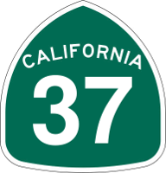
Levee and Shoreline Analysis Task
Justin Vandever, PE AECOM – Oakland, CA justin.vandever@aecom.com
Sarah Kassem, PE AECOM – Oakland, CA sarah.kassem@aecom.com
SR 37 Design Alternatives Assessment
SR 37 Policy Committee – March 1, 2018
Notes:
Will present the findings of the shoreline task, which is meant to address solutions to prevent near-term flooding along SR 37

Slide 2
Introduction & Approach
Shoreline Analysis Task Goal
Identify potential strategies to mitigate near-term flood risks to SR 37 prior to implementation of the corridor-wide project
Educate stakeholders about near-term flood vulnerabilities along the SR 37 corridor and potential mitigation actions
Approach
Identify locations of potential shoreline overtopping for various SLR/storm scenarios
Identify potential for other shoreline deficiencies (erosion, instabilities, seepage)
Develop toolbox of conceptual design strategies
Evaluate applicability of each strategy to different shoreline types
Develop cost estimate to meet different levels of near-term flood protection

Slide 3
What is included in this evaluation?
High level evaluation of levee and shoreline elevations relative to Bay flood levels
Identification of potential flood mitigation strategies to address near-term flood vulnerabilities
Estimation of magnitude and extent of necessary levee and shoreline crest elevation improvements
Rough order of magnitude cost estimate to address levee and shoreline elevation deficiencies along SR 37 corridor

Slide 4
What is NOT included in this evaluation?
Geotechnical evaluation of levee and shoreline condition and stability
Estimation of costs to address potential geotechnical issues
Site-specific engineering design or a specific project recommendation
Estimation of environmental mitigation or land acquisition costs
Assessment of combined riverine-coastal flooding

Slide 5
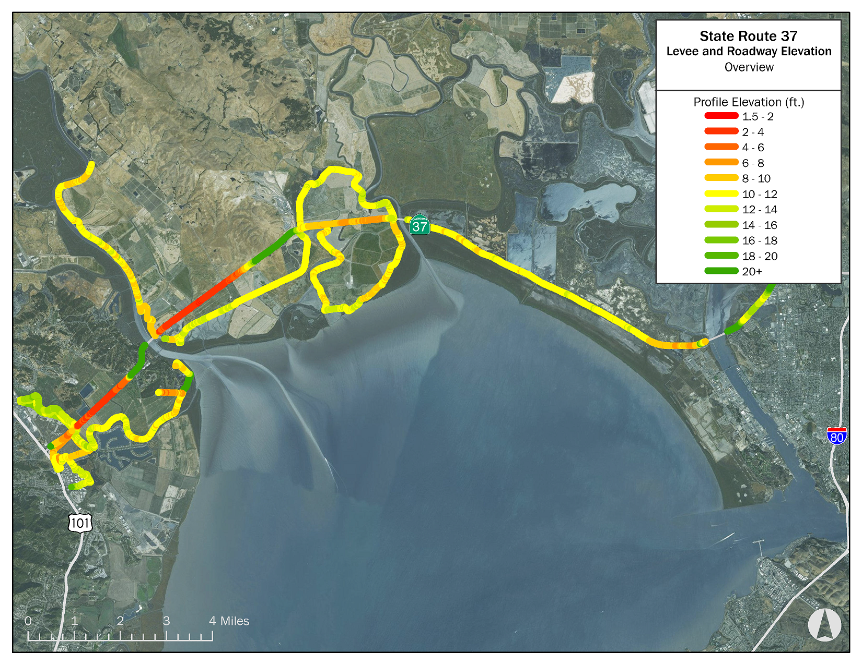
Levees protect low-lying portions of SR 37

Slide 6
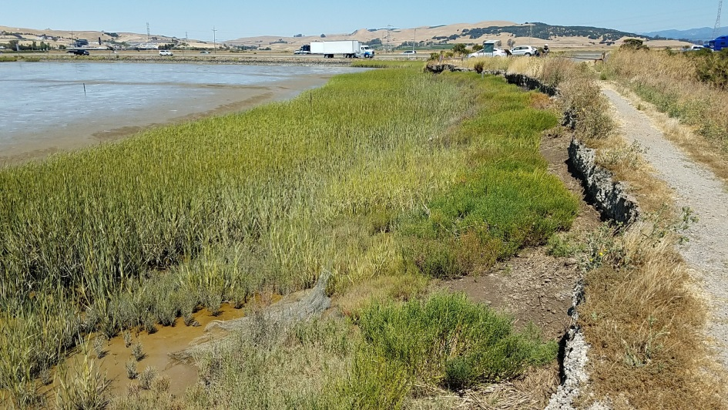
Levees protect low-lying portions of SR 37
Completed review of levee ownership
Private
Public
Approximately 20 different land owners/managers
No single coordinating entity
Levees protect existing land uses
Agricultural
Biosolids/soil amendment
Shallow pond habitat
Road and railway
Other

Slide 7
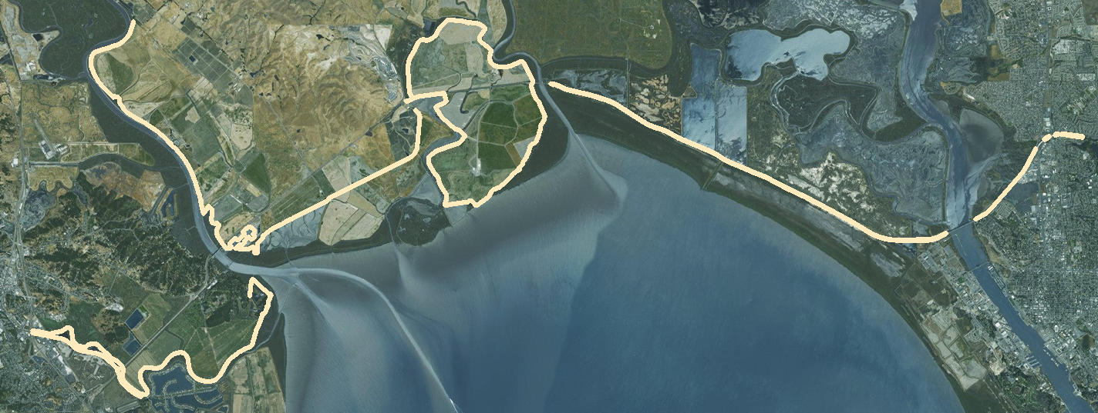
Critical Shoreline
Shoreline segments that provides direct flood protection to SR 37
A1: Novato Creek levees
A2: Petaluma River levees & Port Sonoma shoreline
B1: Tolay Creek/Tubbs Island levees
B2: SR 37 from Sonoma Creek to Napa River (incl. Mare Island)
C: SR 37 from Novato Creek to I-80
B1
B2
C
A2
A1

Slide 8
Potential Shoreline Deficiencies
Freeboard – Is the shoreline, levee, or roadway high enough to prevent overtopping by floodwaters? [focus of this evaluation]
Erosion* – Have waves or high flows eroded the shoreline or levee?
Seepage* – Is the shoreline or levee an effective barrier to flow through or underneath?
Stability* – Is the shoreline or levee stable from a geotechnical standpoint?
*Not evaluated in detail in this assessment and not included in cost estimate

Slide 9
Levee Deficiencies
Freeboard
Erosion

Slide 10
Levee Deficiencies
Seepage
Stability

Slide 11
Overtopping Deficiencies
Evaluate length of shoreline exposed to overtopping
Multiple storm and SLR scenarios for present day and 2050
Differentiated between roadway and levee segments
Roadway
Levee

Slide 12
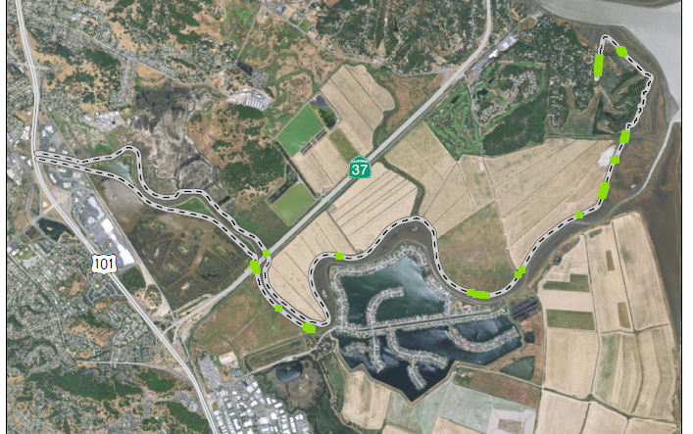
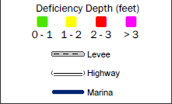
Overtopping Deficiencies for A1
Present Day 10-yr Storm/2050 1-yr Storm
2% of shoreline is deficient
45% of shoreline is deficient during 100-yr storm in 2050

Slide 13
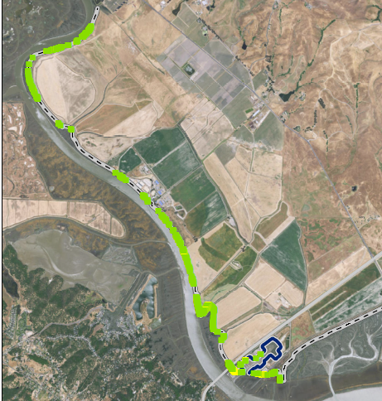
Overtopping Deficiencies for A2
Present Day 10-yr Storm/2050 1-yr Storm
11 miles of levee protect 4 miles of highway
11% of shoreline is deficient
80% of shoreline is deficient during 100-yr storm in 2050

Slide 14
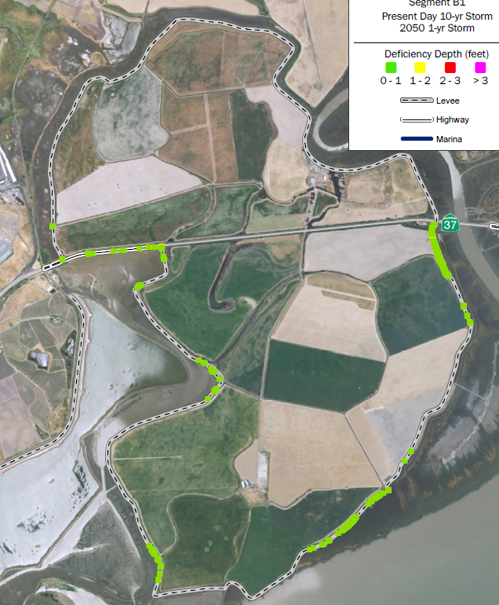
Overtopping Deficiencies for B1
Present Day 10-yr Storm/2050 1-yr Storm
11 miles of levee protect 2 miles of highway
6% of shoreline is deficient
80% of shoreline is deficient during 100-yr storm in 2050
Tolay Lagoon:
2800 ft flood wall along roadway
3500 ft levee improvement along adjacent levee segments
Notes:
Tolay Lagoon
2800 ft of flood wall along the highway
Wall height: 2 ft
3500 ft of levee improvements along Tubbs Island levees immediately adjacent to highway

Slide 15
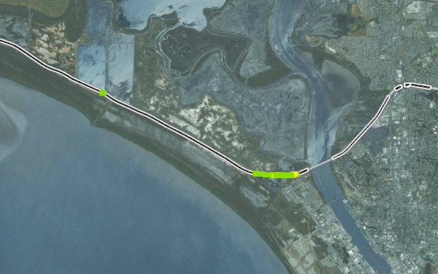
Overtopping Deficiencies for B2&C
Present Day 10-yr Storm/2050 1-yr Storm
5% of shoreline is deficient
40% of shoreline is deficient during 100-yr storm in 2050
Mare Island:
1600 ft flood wall along south side of roadway
Flood waters come from south side

Slide 16
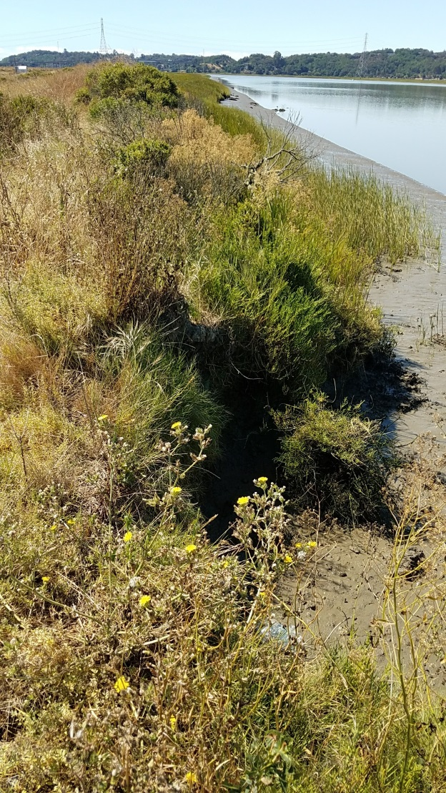
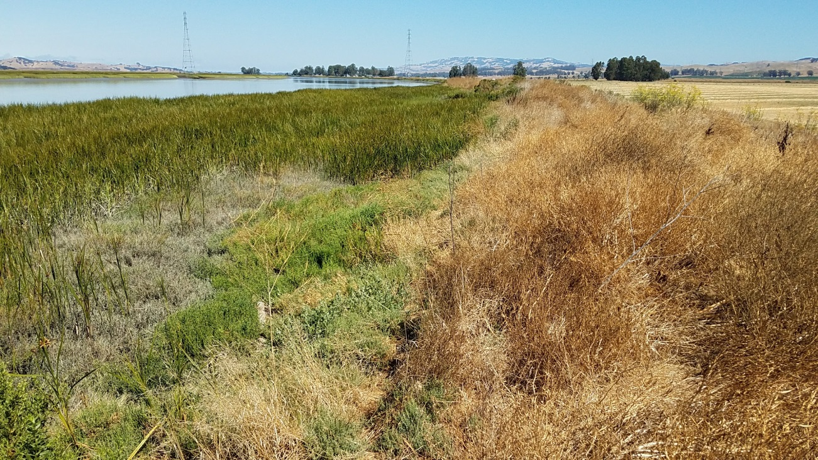
Minor Shoreline Deficiencies
Lack of patrol road
Insufficient geometry
Excess vegetation
Animal burrows

Slide 17
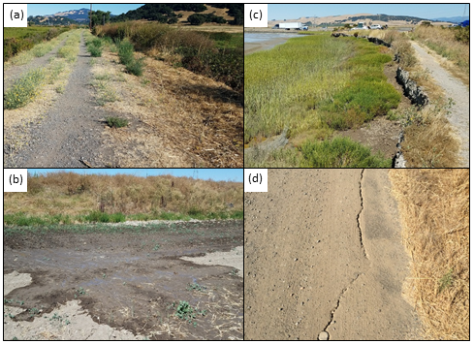
Field Visit Observations
Excess Vegetation
Erosion
Seepage
Stability
Notes:
Erosion reduces the crest width and makes breaching more likely.
Seepage can reduce stability and lead to failure on the landward side of the levee, etc.

Slide 18
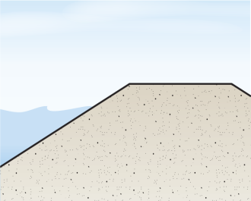
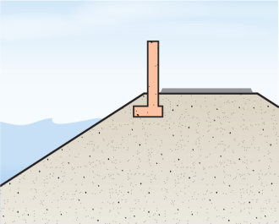
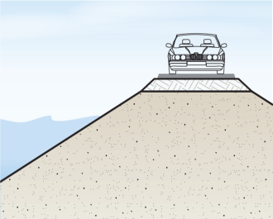
Potential Adaptation Strategies
Levee Improvements
Shoreline Improvements
Concrete wall along edge of roadway
Sheet pile wall along edge of roadway
Roadway Improvements
Stability berm on landside slope
Seepage berm on landside slope
Erosion protection on waterside slope
Raise elevation of roadway surface
Install drainage
Raise elevation of existing levee
Notes:
The next step in the study was to identify a range of strategies that can be applied along the corridor along to prevent inundation of the roadway. The strategies are summarized in this toolbox, which groups the strategies according to the type of shoreline that they can be applied to.

Slide 19
Levee Improvements
Overtopping – raise crest
Stability and seepage – add stability berm
Erosion – add rock slope protection
Notes:
The strategies to improve the levee, in addition to addressing overtopping, also address deficiencies due to stability, seepage and erosion
Decided to not consider floodwall in levee bc more expensive

Slide 20
Shoreline Improvements
Concrete wall
Exposed
Sheet pile wall
Sheltered
Applicable to roadway shoreline:
Mare Island
Tolay Creek
Not applicable to roadway in A1 & A2 because road surface too low
Erosion protection in areas exposed to waves
Potential drainage improvements

Slide 21
Raise Roadway
Need to tie into existing roadway elevation
Only appropriate where overtopping deficiencies are small
May not be feasible due to traffic impacts
Applicable to Mare Island and Tolay Lagoon low spots

Slide 22
Estimating Costs
Estimated average dimensions for existing levee and roadway
Assumed an average raised height of 2 ft for all strategies
Costs include:
Direct unit costs
Indirect unit costs (15%)
Overhead and profit (21%)
Construction contingency (25%)
Design fee and contingency (25%)
Environmental clearance (10%)
Not included:
Environmental mitigation
Land acquisition costs
Adaptation Strategy | Cost | Unit
Raise levee | $1000 | LF
Concrete wall | $1610 | LF
Sheet pile wall | $1880 | LF
Raise roadway | $970 | LF
LF = linear feet (cost per foot of improvement)
Costs developed for overtopping strategies only (not seepage, erosion, stability, etc.)

Slide 23
Shoreline Protection Cost Estimate
For 2050 flood protection (12’’ of SLR)
Scenario | Segment A1 | Segment A2 | Segment B1 | Segment B2
High tide | $ - | $ 0.5M | <$ 0.5M | $ 0.5 – 1 M
1-yr | $ 1M | $ 6 – 7M | $ 3M | $ 3 – 7M
10-yr | $ 11M | $ 23 – 25M | $ 25 – 26M | $ 10 – 19M
Ranges in cost due to alternative options
Costs to mitigate overtopping deficiencies only
Notes:
To estimate the cost of bringing each roadway segment up to a specific level of flood protection, we multiplied the unit cost of each strategy by the total length of deficient shoreline for each segment and each storm scenario.
Costs only to prevent overtopping
Costs do not consider drainage, and other levee improvements such as erosion, seepage or stability
How were cost ranges developed?
Q: for Segment B2 (2050 100yr) - what would make them select the higher cost configuration? Based on detail assessment that may be the best option?

Slide 24
Shoreline Protection Cost Estimate
Scenario | Existing Conditions | 2050 (1 ft SLR)
High tide | $ - | $ 1 – 2M
1-yr | $ 2 – 3M | $ 14 – 18M
10-yr | $ 14 – 18M | $ 69 – 81M
Ranges in cost due to alternative options
Costs to mitigate overtopping deficiencies only

Slide 25
Cost Estimate Assumptions
Does not include environmental mitigation or land acquisition costs
Does not address potential levee erosion, seepage, or stability issues, which could increase costs above estimates
Represents a minimum level of investment needed to provide flood protection
Evaluated strategies would likely provide up to 10-year flood protection with 1 ft of SLR
Notes:
Nick –

Slide 26
Substantial investment required to maintain adequate level of flood protection
Evaluation considered concept level strategies to address weak links in levee and shoreline elevations
Further geotechnical evaluation would likely identify need for additional levee improvements beyond those identified in this study
Small-scale fixes can only address near-term flood vulnerabilities for small amounts of SLR (up to 12”)
Long-term corridor-wide solution needed to address higher amounts of SLR

