Slide 1


Speaker: Dan McElhinney, Caltrans
37 Policy Group Meeting
March 1, 2018
SHOPP Program Update and
Route 37/121 Signing/Striping

Slide 2
SB1 and Regional Workload on State Highway System
State Highway Operation and Protection Program (SHOPP)
SB1 Passage Has Accelerated Funding and Delivery
SHOPP 10-Year Plan Development
2018 SHOPP Update
SB1 Congested and Trade Corridors Competitive Programs
Notes:
SHOPP projects are limited to capital improvements relative to the maintenance, safety, operation, and rehabilitation of state highways and bridges which do not add a new traffic lane to the system.
SHOPP: $2.5B/yr statewide, SB1 adds about $1.9B

Slide 3
SB1 and State Highway Operation & Protection Program (SHOPP)
Asset management and fix-it-first priority
Protect, preserve and rehabilitate State Highway System infrastructures
Respond to emergency, safety or mandated needs
Pre-SB1: Average $300 million invested per year for Bay Area
SB1 doubles the investment
Notes:
SHOPP projects are limited to capital improvements relative to the maintenance, safety, operation, and rehabilitation of state highways and bridges which do not add a new traffic lane to the system.
SHOPP: $2.5B/yr statewide, SB1 adds about $1.9B

Slide 4
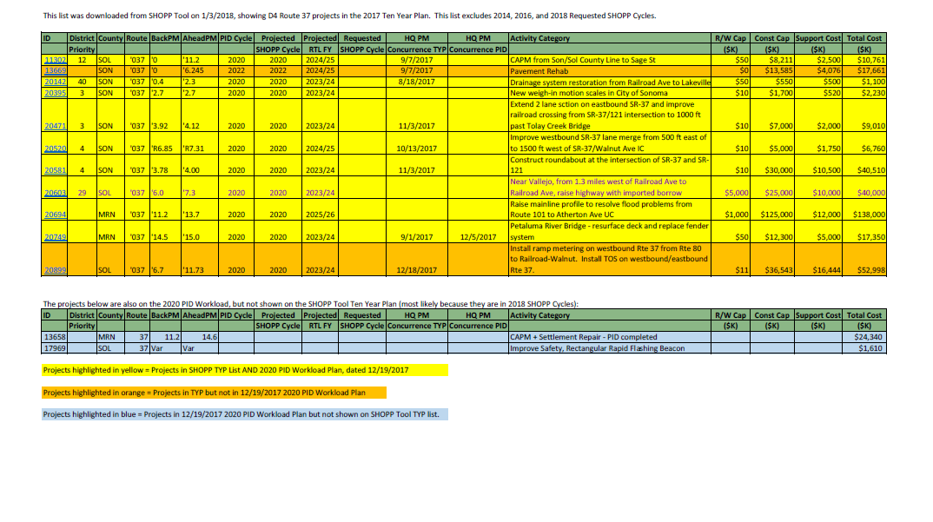
Project Initiation Documents for Project Studies are planned for Route 37:
Proposed SHOPP 10-Year Plan Development
SR 37 Workload List

Slide 5
SR 37 Projects Included in FY 17/18 PID Work Plan
County | Route | Begin Postmile | End Postmile | Purpose & Need | Improvement Description | Project Type and Funding SHOPP (0042), SHOPP SB-1 (3290), State Sponsored (0042) or Reimbursement (0042R)(SHOPP, SHOPP SB-1, State, R) | Anchor Asset (Main Category) | PID Status | % Complete | Target Completion Date (MM/DD/YYYY) | Total Pre-PID Estimated Project Cost ($M) (Construction + ROW + Support Costs) | Target FY for RTL
SOL | 37 | 0.00 | 11.20 | Pavement preservation (Long Lead) | Pavement CAPM from Son/Sol County line to Sage Street UC | SHOPP SB-1 | Pavement | Proposed | 0 | 6/29/2018 | $ 10.76 | 2024/25
SOL | 37 | Various | Various | Improve safety and reduce accidents | In Solano County on various route (Rte. 37, 80 & 780) at various location - Install Flashing Beacons | SHOPP | Safety - Collision Reduction | Active | 35 | 6/29/2018 | $ 1.61 | 2022/23
SON | 37 | 3.78 | 4.00 | Operational Improvements | SON-037-PM3.78/4.00 & SON-121-PM0.00/0.15 - Construct a roundabout at the intersection of SR-37 and SR-121 | SHOPP | Mobility | Proposed | 0 | 6/28/2019 | $ 40.51 | 2025/26 (long L)

Slide 6
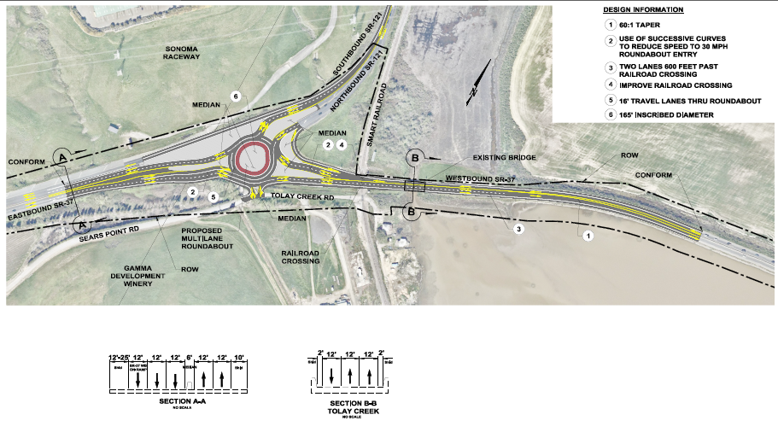

Slide 7
SB1 Accelerated $588 million Funding & 22 SHOPP Projects in District 4
22 SHOPP Projects Accelerated
$588M at recent CTC Meetings
22 SHOPP Projects Accelerated of various assets:
June CTC 2 Projects $35 million | August CTC 2 Projects $41 million
July CTC 3 Projects $187 million | October CTC 15 Projects $325 million
Bridge 8 Projects $213 million | Mobility 6 Projects $164 Million
Pavement 5 Projects $187 million | Drainage 3 Projects $24 million

Slide 8
SB1 Accelerated Delivery of 5 Projects $61 million in Summer 2018

Slide 9
SB1 Accelerated Funding in Bay Area
3 New I-80 Freight Corridor Improvement Projects - $143 million for FY 2019/2020

Slide 10
District 4 - 10-Year SHOPP Investment

Slide 11
District 4 - 10-Year SHOPP Investment
FY | Total Number of Projects | Construction Capital Cost (million)
2017/18 | 61 | 356
2018/19 | 28 | 301
2019/20 | 50 | 665
2020/21 | 29 | 223
2021/22 | 42 | 535
2022/23 | 63 | 420
2023/24 | 105 | 758
2024/25 | 84 | 704
2025/26 | 80 | 762
2026/27 | 80 | 980
Total | 622 | $5,701
D-4 SHOPP 10-Year Plan
County | Number of Projects | Construction Capital Cost (million)
ALA | 141 | 1,493
CC | 47 | 408
MRN | 45 | 437
NAP | 49 | 269
SCL | 94 | 975
SF | 30 | 404
SM | 75 | 480
SOL | 56 | 480
SON | 85 | 755
Total | 622 | $5,701
D-4 SHOPP 10-Year Plan
Assets | Number of Projects | Construction Capital Cost (million)
Bridge | 68 | 322
Pavement | 137 | 2,503
Drainage | 53 | 145
TMS | 107 | 1,357
Others | 257 | 1,374
Total | 622 | $5,701

Slide 12
District 4 - Draft 2018 SHOPP
D-4 2018 SHOPP Summary
County | Number of Projects | Construction Capital Cost (million)
ALA | 46 | 547
CC | 10 | 163
MRN | 10 | 51
NAP | 11 | 52
SCL | 25 | 284
SF | 9 | 191
SM | 15 | 125
SOL | 7 | 129
SON | 16 | 178
Total | 149 | $1,720
D-4 Draft 2018 SHOPP Summary
Assets | Number of Projects | Construction Capital Cost (million)
Bridge | 28 | 147
Drainage | 4 | 29
Pavement | 23 | 668
TMS | 8 | 101
Others | 86 | 774
Total | 149 | $1,720

Slide 13
District 4 - Candidates for SB1 Congested & Trade Corridors Programs
 | County | Route | PM | Project Name | Project Description | FY | Construction Capital ($1000)
1 | SOL | 80 | R10.4 / 30.2 | Sol 80 Express Lanes | Construct new express lanes and convert existing HOV lanes to express lanes from Red Top Road to Air Base Parkway | 17/18 | $131,000
2 | SON | 101 | 4.0 / 7.1 | Marin Sonoma Narrows HOV | Add 1 HOV lane in each direction from the SR 116 interchange to north of Corona Road | 18/19 | $75,900
3 | SM SCL | 101 101 | 0.000 / 21.8 45.7 / 52.6 | SM/SCL 101 Managed Lane Project | San Mateo & Santa Clara Counties: Managed lanes from near SR 237 to north of I-380. | 18/19 | $416,000 $47,100
4 | MRN | 101 | 20.9 / 27.0 | Marin Sonoma Narrows HOV | Construct HOV lane: northbound from 1.8 mile north of Atherton Avenue to 0.6 mile south of the Marin/Sonoma County line and southbound from 0.6 mile south of the Marin/Sonoma County line to the Franklin Avenue Overhead | 19/20 | $78,800
5 | SOL | 80 | 10.6 / 13.5 | 80/680/12 ICP | Packages 2A, 2B and 3: provide new connector from eastbound SR-12 to eastbound I-80, new connector from westbound I-80 to southbound I-680 and improve connections to the Red Top Road interchange. | 19/20 20/21 | $95,000 $85,000
6 | SOL | 80 | 14 / 15.7 | I-80 WB Cordelia Truck Scales Relocation Project | Replace existing truck scales on WB I-80 at Cordelia with new facility at 0.7 miles east of existing location, and add new braided off-ramp connection, new entrance ramp connection to WB I-80 and direct access from westbound SR-12. | 19/20 | $115,500
7 | ALA | 680/84 | 10.3/15.3 17.9/22.9 | 680/84 I/C Improvement & Expressed Lane Extension | Make operational improvements to SR84/I-680 interchange and extend southbound express lane about two miles to the north. | 20/21 | $145,640
 |  |  |  |  |  |  | $1,189,940

Slide 14
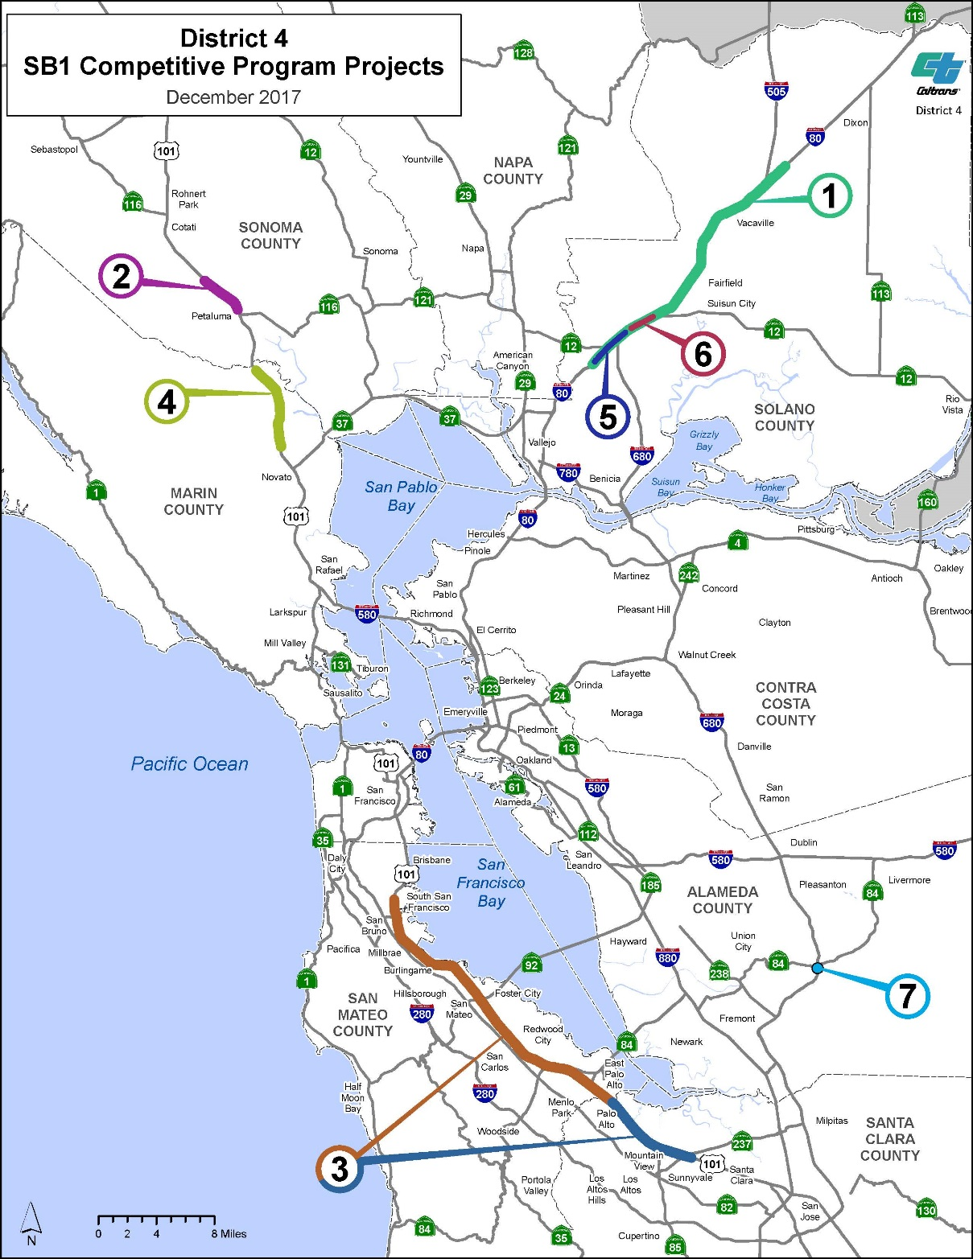
District 4 - Candidates for SB1 Congested & Trade Corridors Programs
 | County | Route | PM | Project Name
1 | SOL | 80 | R10.4/30.2 | Sol 80 Express Lanes
2 | SON | 101 | 4.0/ 7.1 | Marin Sonoma Narrows HOV
3 | SM/SCL | 101 101 | 0.000/ 21.8 45.7 / 52.6 | SM/SCL 101 Managed Lane
4 | MRN | 101 | 20.9 / 27.0 | Marin Sonoma Narrows HOV
5 | SOL | 80 | 10.6 / 13.5 | 80/680/12 ICP
6 | SOL | 80 | 14 / 15.7 | I-80 WB Cordelia Truck Scales Relocation Project
7 | ALA | 680/84 | 10.3/15.3 17.9/22.9 | 680/84 I/C Improvement & Expressed Lane Extension

Slide 15
District 4 - 10-year SHOPP Investment
And Potential Congested/Trade Corridors Competitive Programs (1st Cycle)

Slide 16
District 4 - 10-year SHOPP Investment
And Potential Congested/Trade Corridors Competitive Programs (1st & 2nd Cycles)

